Slide 1
Chapter 1 – Algorithm Analysis
Contents
Introduction to computing
Algorithms
Experimental analysis
Pseudocode
Random access machine
Functions in algorithm analysis
Asymptotic analysis
Asymptotic notation
Big-Oh, Big-Omega, Big-Theta, Little-Oh, Little-Omega
Examples
Search
Prefix averages
Maximum contiguous subsequence sum
Java and Eclipse
©This course material was prepared and is owned by Dr. Luis Rueda. It shall not be reproduced or used without permission

Slide 2
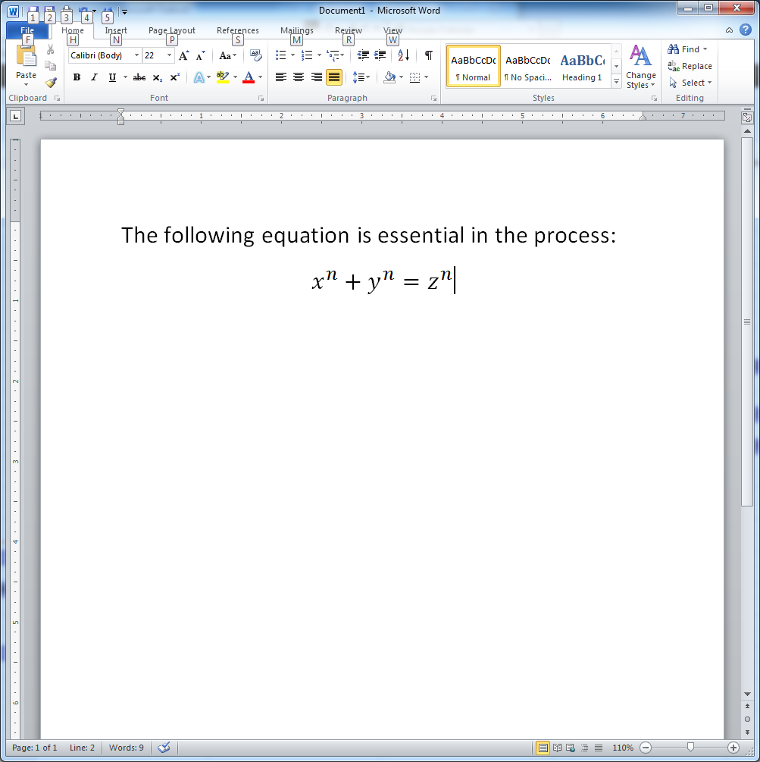
Computing: What is computer science?
My computer crashed ☹
How do I fix it?
How do I insert an equation in MS Word? ☺
None of these!

Slide 3
Chapter 14 – Game Playing
From late 1960s to mid-1970s, computer chess improved from beginner-level to middle-level
1967 check-playing, Arthur Samuel, improved by refining search procedure and incorporated better “book-learning” capabilities, calculating position by hierarchical organized tables, instead of adding up weighted feature values.
1959-1962, chess-playing, MIT student, advised by John McCarthy, based on McCarthy’s earlier programs for IBM 704, run on IBM 7090, amature with about 100 games experience, neither brilliant nor stupid, occasionally blunders. -> to Stanford along with McCarthy.
Meantime, chess program by Georgi Adelson-Velskiy and colleagues in Alexander Kronrod’s laboratory at ITEP in Moscow.
Match 1967 Nov 22 – Kotok-McCarthy VS Russian program at ITEP – continuing for nine months, 2 draw (weak Russian version), 2 loss (stronger Russian version). The ITEP program was the forerunner of Kaissa much improved version, by Misha Donskoy, Vladimir Arlazarov, Alexander Ushkov at Institute of Control Science in Moscow.
©This course material was prepared and is owned by Dr. Luis Rueda. It shall not be reproduced or used without permission

Slide 4
Chapter 14 – Game Playing
Richard Greenblatt, expert in programming and chess-playing, at AI Lab at MIT, incorporated a number of excellent heuristics for choosing and evaluating moves, improved Kotok’s to MAC HACK VI, first one playing in tournaments against human players, won 2, drew two, achieving rating of 1450 on the U.S Chess Federation rating scale, at the level of an amateur human player. Beat Hubert Dreyfus, AI critic in 1967
Grand Masters
International Masters
National Masters
Experts
Class A
Class B
Class C
©This course material was prepared and is owned by Dr. Luis Rueda. It shall not be reproduced or used without permission

Slide 5
Chapter 14 – Game Playing
1968, Inspired by MAC HACK, John McCarthy, made a bet with David Levy, Scottish international master, computer chess program will win him within 10 years.
Around 1970, three students at Illionois, David Slate, Larry Atkin, and Keith Gorlen, began writing a series of chess programs, CHESS 3.0 rating 1400 (MAC HACK VI not among them), 100 positions per second, Northwestern. And CHESS 4.6
1974, CHESS 4.2 was beaten by Kaissa, which is the world championship in computer chess.
Difference between computer and human in playing chess:
 | Knowledge | calculation
Human | Prodigious | Small amount
Computer | None or little rules | Tremendous calculation in large search for optimal maneuver
©This course material was prepared and is owned by Dr. Luis Rueda. It shall not be reproduced or used without permission

Slide 6
Chapter 14 – Game Playing
Efficient Machine code, special machine
©This course material was prepared and is owned by Dr. Luis Rueda. It shall not be reproduced or used without permission

